Slide 1
FIRST SEMESTER
MATHEMATICS I
11
Limits And Continuity

Slide 2
Outlines
Limit of a Function
Calculating Limits Using the Limit Laws
One-Sided Limits and Limits at Infinity
One-Sided Limits
Limits Involving (sin 𝛉)/𝛉
Finite Limits as
Continuous Functions
x → ±∞

Slide 3

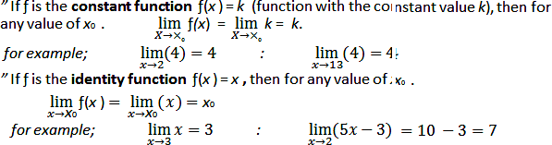
Limit of a Function
Let ƒ(x) be defined on an open interval about x₀ except possibly at itself. We say that the limit of ƒ(x) as x approaches x₀ is the number L, and write

Slide 4
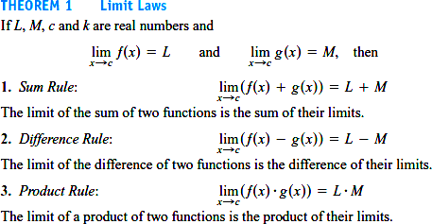
Calculating Limits Using the Limit Laws
The next theorem tells how to calculate limits of functions

Slide 5
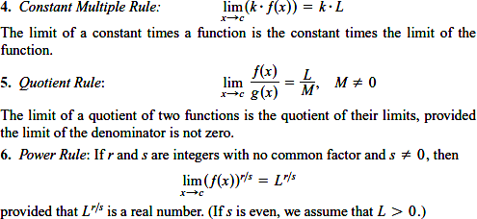

Slide 6
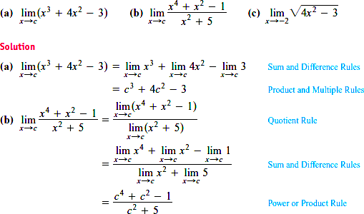
EXAMPLE 1:
Using the Limit Laws to find the following limits.

Slide 7
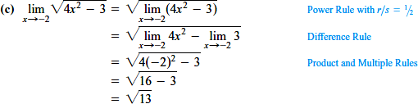


Slide 8
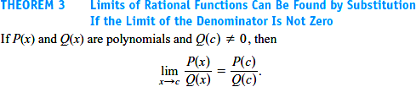



Slide 9
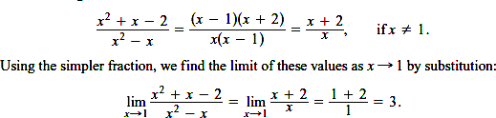

Solution : We cannot substitute because it makes the denominator zero.

Slide 10
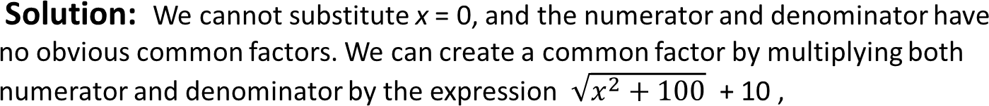
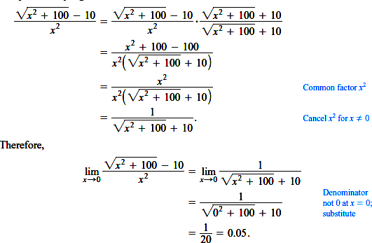

Slide 11
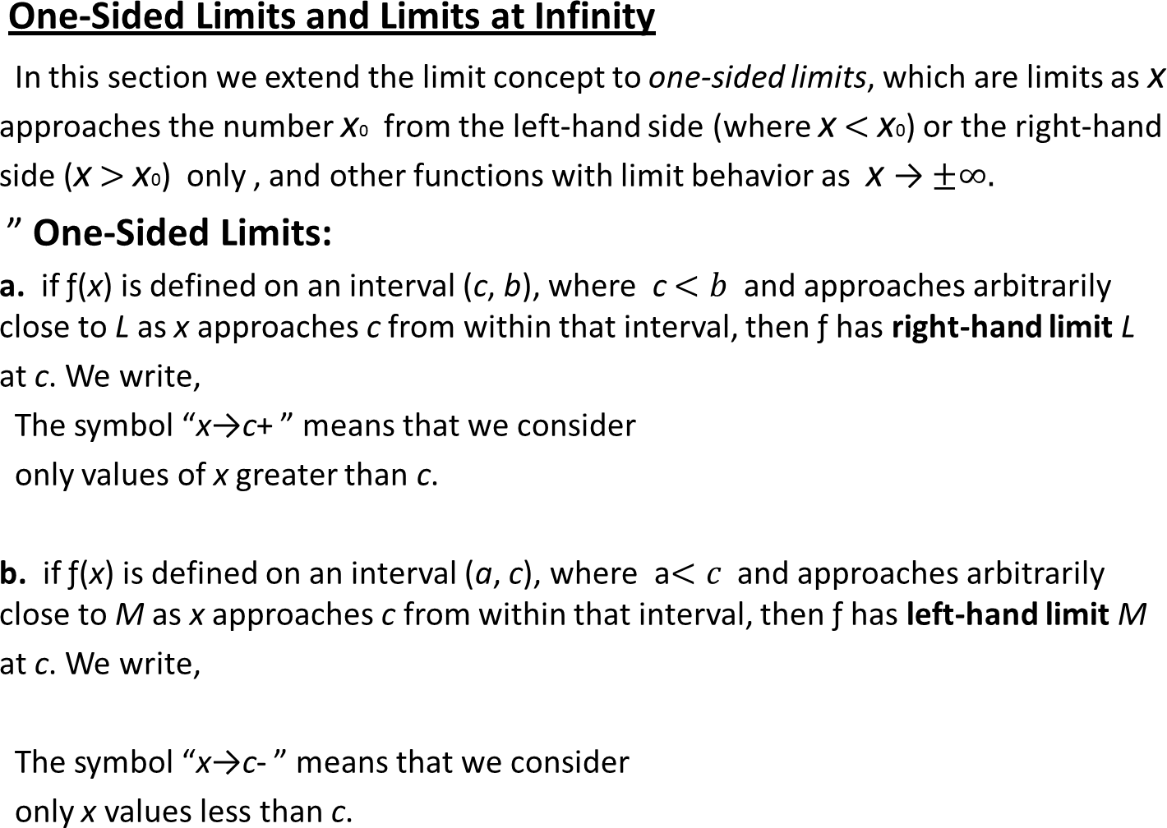

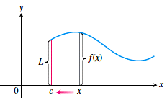

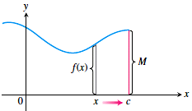

Slide 12
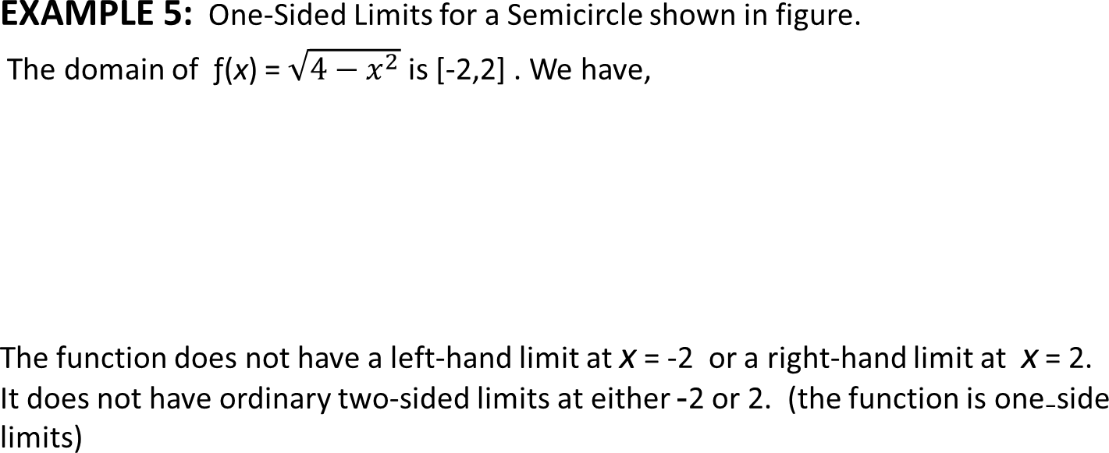
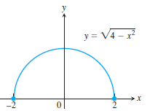



Slide 13
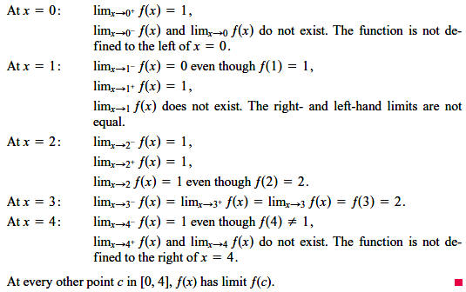
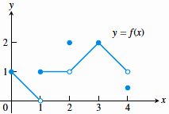
EXAMPLE 6: Limits of the Function Graphed in Figure.

Slide 14
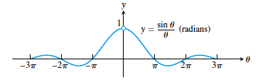


Limits Involving (sinθ) θ
A central fact about (sin𝛉) ⁄ 𝛉 is that in radian measure its limit as 𝛉→ 0 is 1. We can
see this in Figure,
EXAMPLE 7:
Show that,
a.
b.

Slide 15
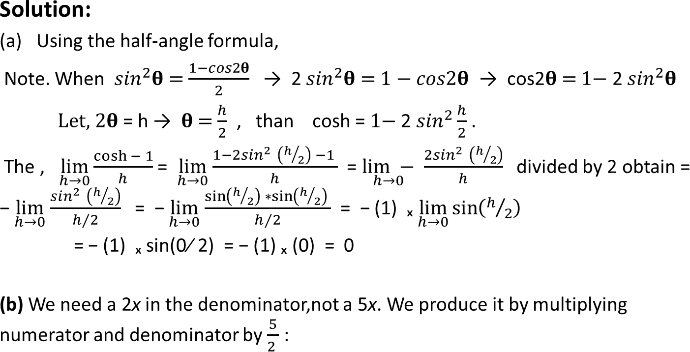
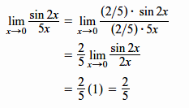

Slide 16


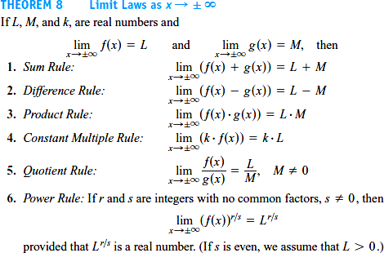
Finite Limits as
x → ±∞

Slide 17
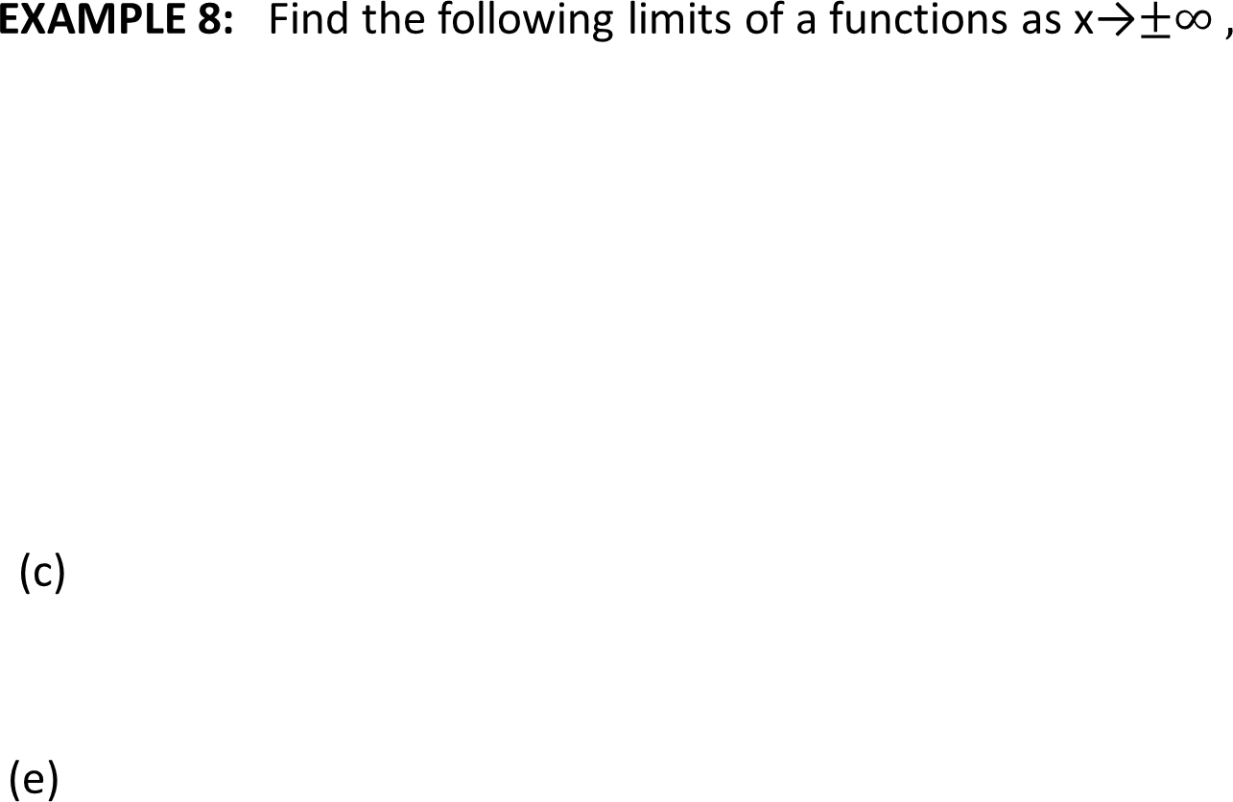

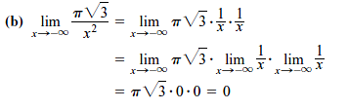
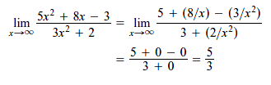

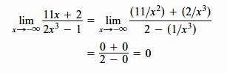


Slide 18
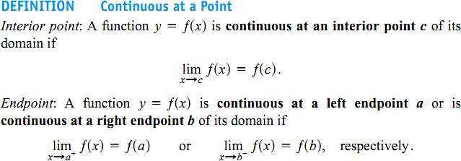

Continuous Functions

Slide 19
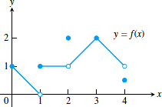
EXAMPLE 9:
Find the points at which the function ƒ in Figure is continuous and the points at which ƒ is discontinuous.
Solution:
The function ƒ is continuous at every point in its domain [0, 4] except at x = 1, x = 2, and x = 4.

Slide 20
